Slide 1


Getting Started – Hello world
Build a basic with

Slide 2

Get the tools
Download and install Visual Studio
We will do everything in Windows with Visual Studio 2022
you can use different development environment and OS
You can do basic installation
we will only do C++ coding for Windows applications for now
Download JUCE from https://juce.com/download/
Unpack JUCE folder
Put it in some location on your computer
I put it in C:/Program Files
Notes:
If you haven’t already, you need to download an Integrated Development Environment, or IDE. In this example, we will do everything in Windows with Visual Studio, but the steps should be similar with different development environments and operating systems.
When installing, you should be able to do a basic installation, needing only C++.
Now download JUCE from https://juce.com/download/ . Unpack the JUCE folder and put it in some convenient location on your computer.

Slide 3
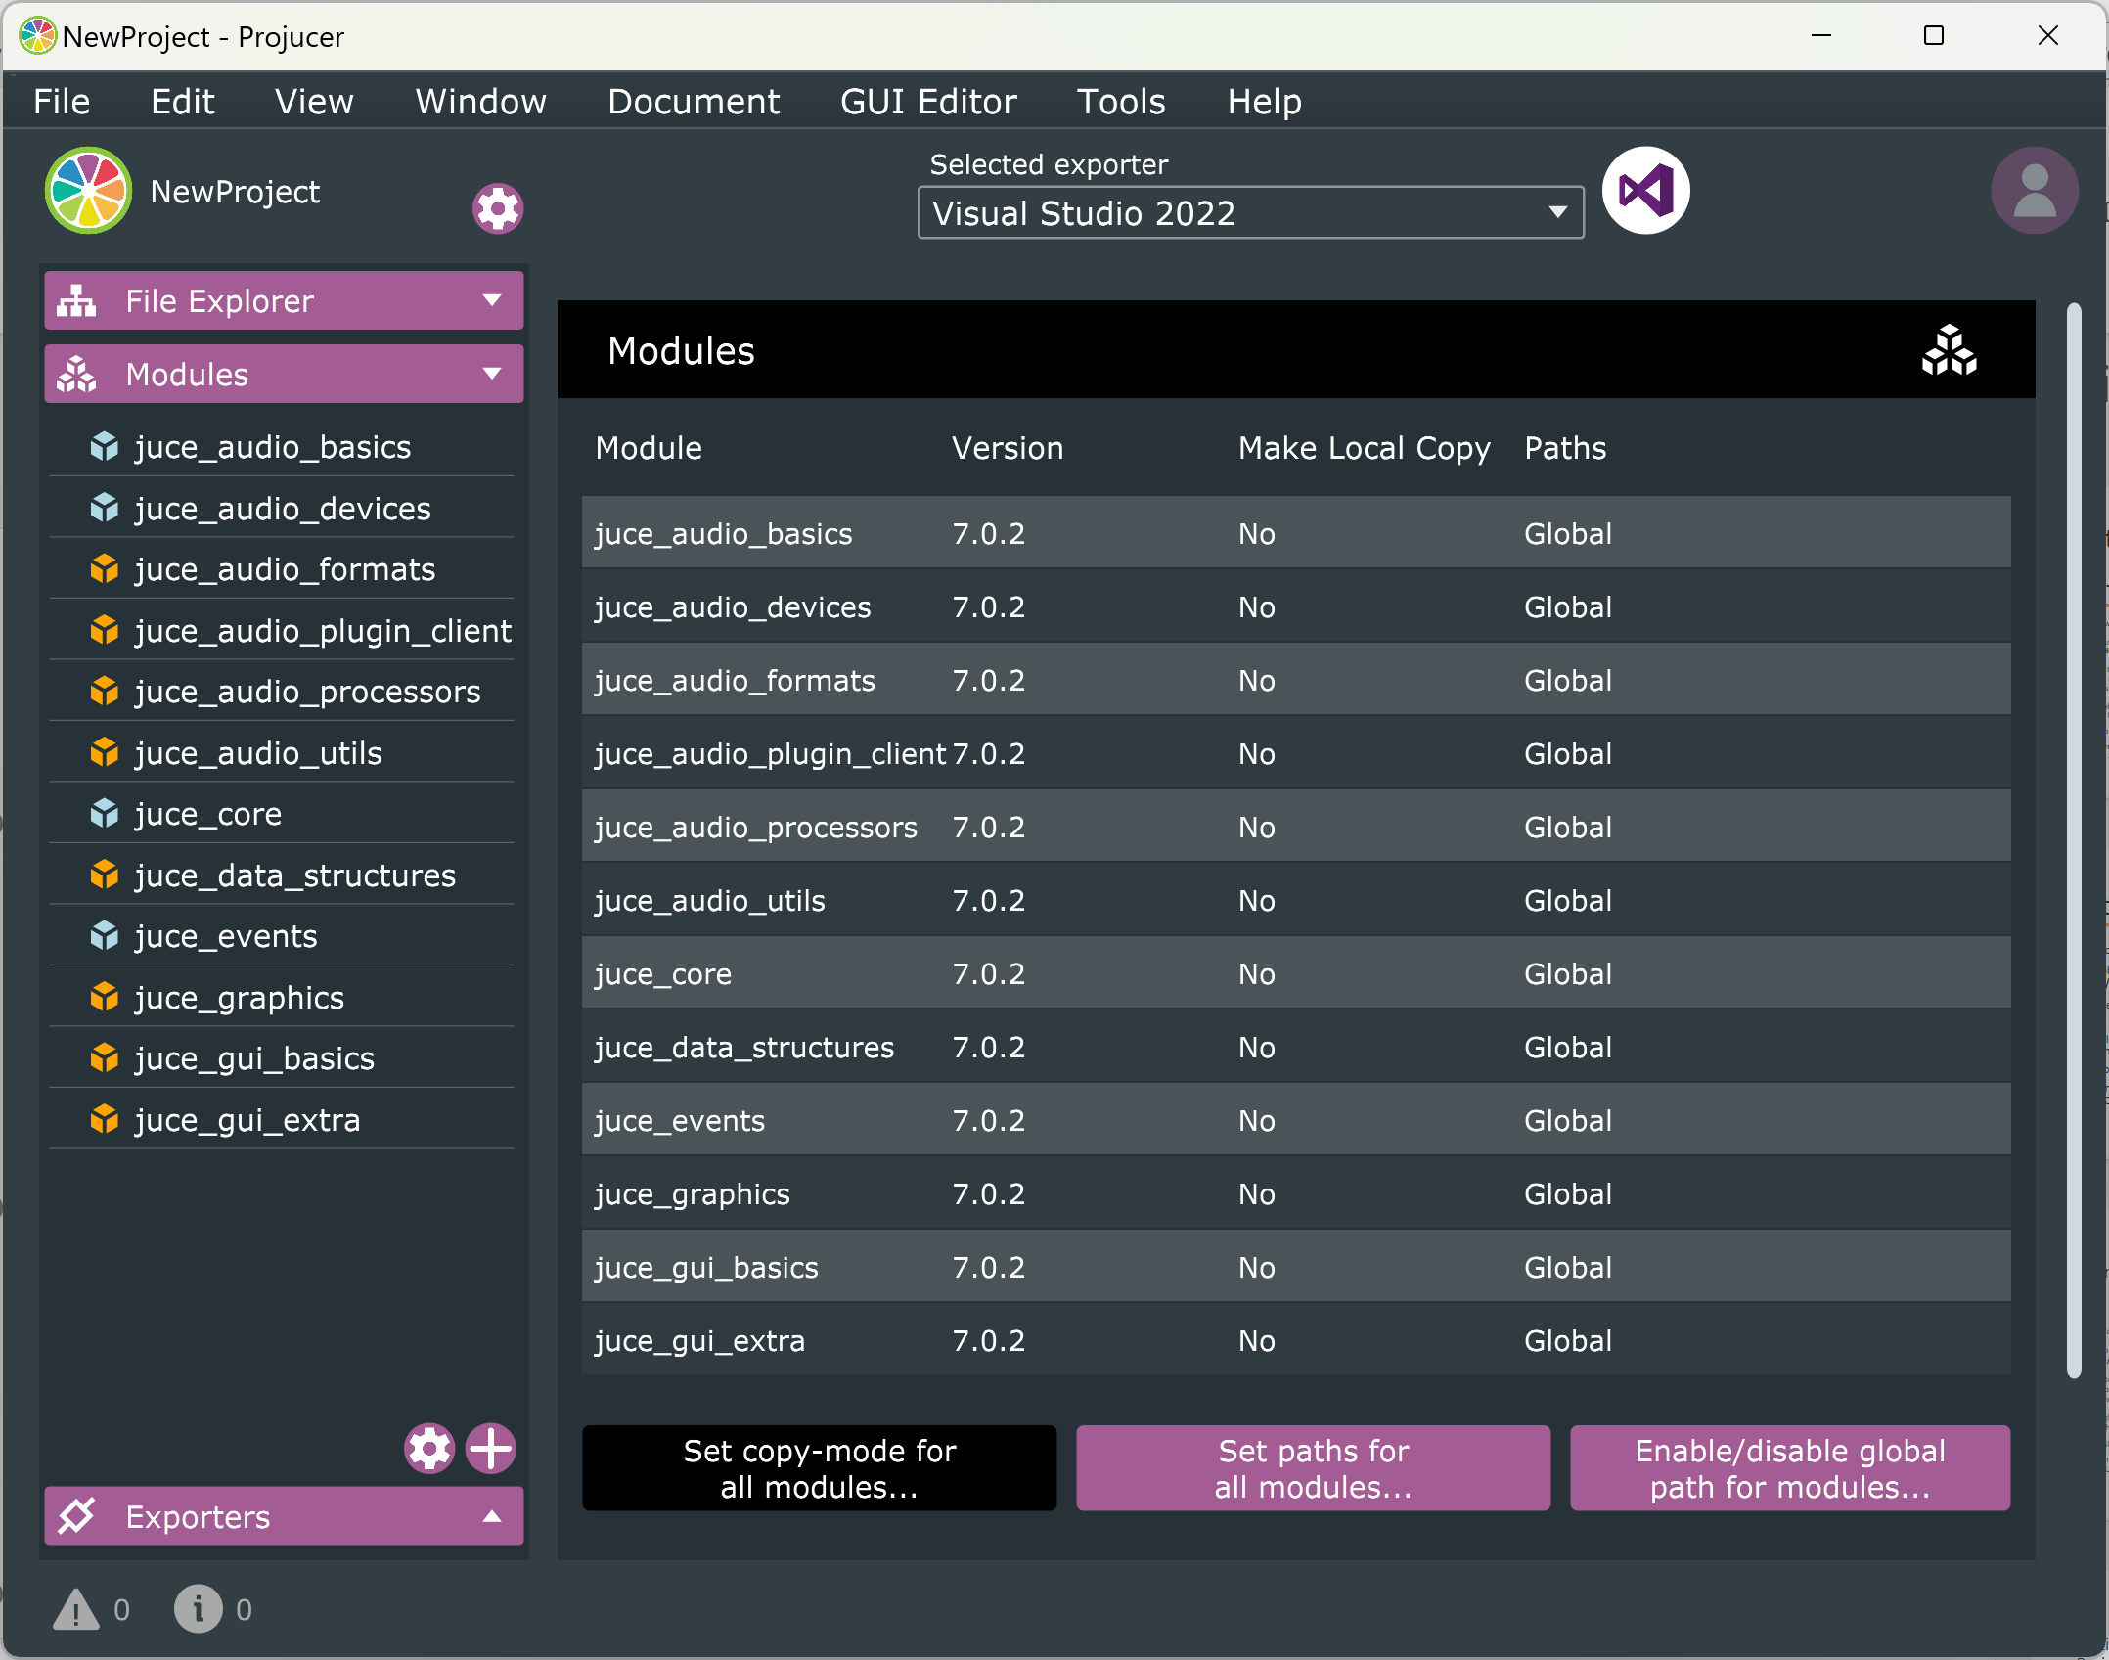
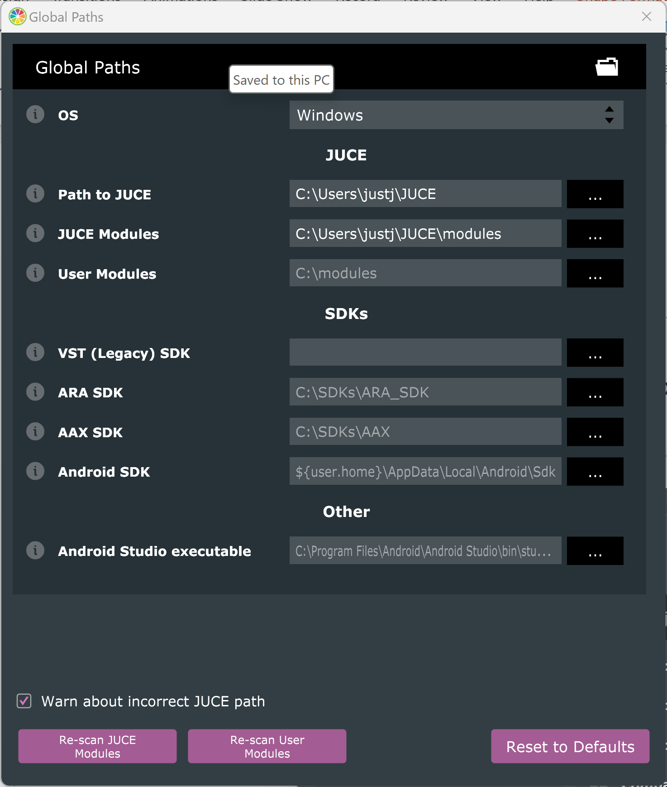
Setting up the Projucer
1
After downloading Juce, run Projucer
Global paths need to be set in Projucer app
Navigate to menu item Projucer > Global Search Paths on MacOS or File > Global Search Paths on Windows and Linux.
Set global paths for JUCE and JUCE modules to the right locations
Close the Global Paths window
click Modules on the left
Then clicking the settings Cog Icon on bottom left
Then Enable/disable global path for modules...
2
3
4
Notes:
After downloading Juce, run the Projucer
Use global search paths for modules by
clicking Modules on the left
Then clicking the settings Cog Icon on bottom left
Then Enable/disable global path for modules...

Slide 4
Setting up the Projucer
Global paths need to be set in Projucer app
Navigate to menu item Projucer > Global Search Paths on MacOS or File > Global Search Paths on Windows and Linux
Open global paths and set them to the right locations
I needed to reset global paths for JUCE and JUCE modules
Notes:
Global paths need to be set in Projucer app
Navigate to menu item Projucer > Global Search Paths on MacOS or File > Global Search Paths on Windows and Linux
Open global paths and set them to the right locations
I needed to reset global paths for JUCE and JUCE modules

Slide 5
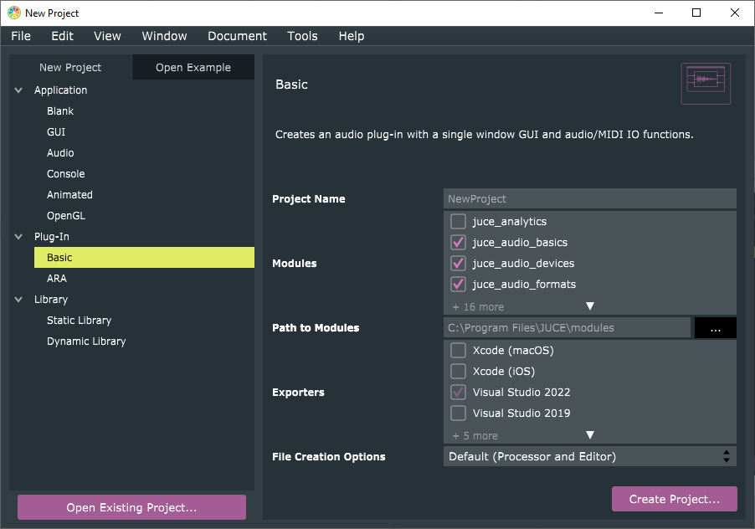
The project type
Projucer automatically generates different starter files depending on what you want to create
Select Plug-In -> Basic
We will develop a basic audio plugin
Give the project a name like ‘Hello World v1’ in the Project Name text field.
Make sure your development environment is selected under Exporters
Click the Create Project… button

Slide 6
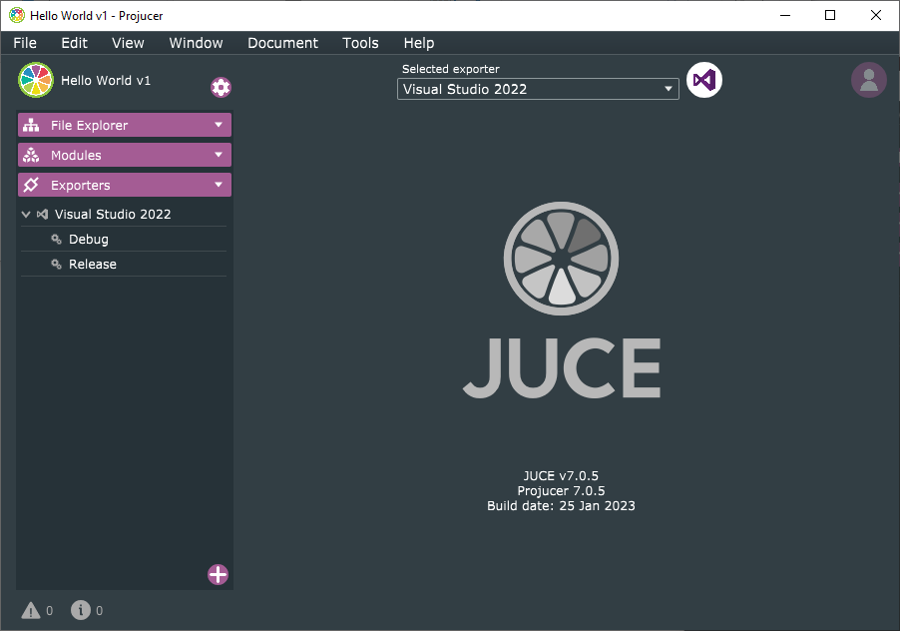
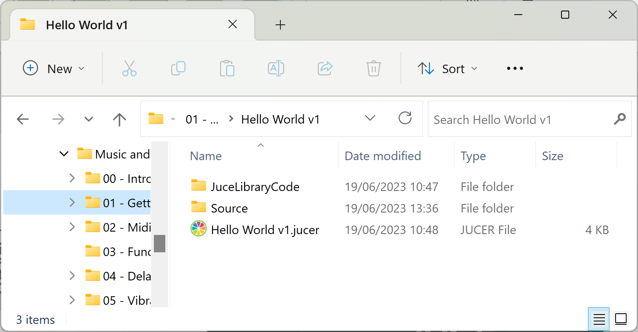
The project type
Choose a folder for your project
You should now see this ‘Hello World v1’ folder in the project folder
Projucer also displays a new screen now
File Explorer
Modules
Exporters

Slide 7
The project type
Choose a folder for your project
You should now see this ‘Hello World v1’ folder in the project folder
Projucer also displays a new screen now
File Explorer
Modules
Exporters

Slide 8
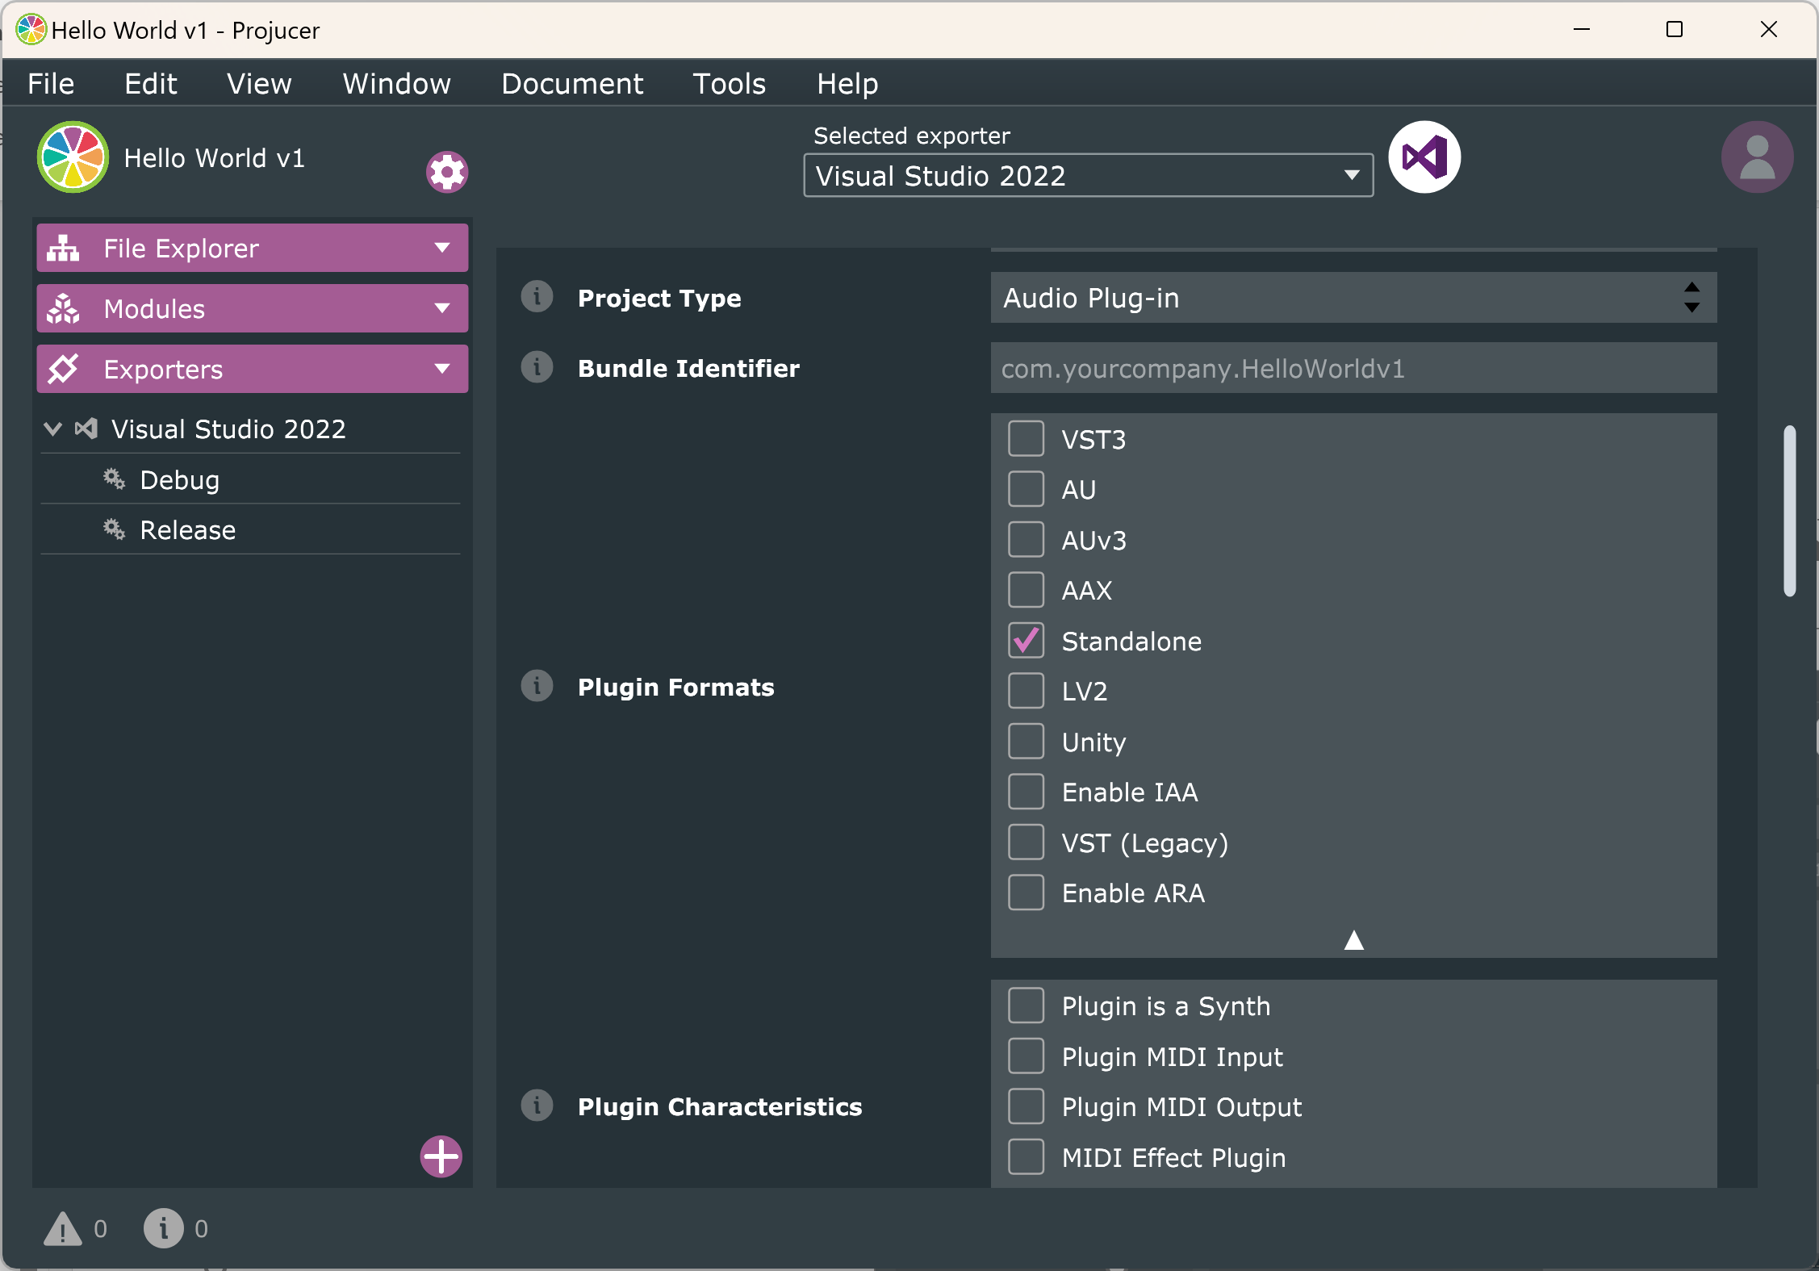
Overview
Open settings by clicking Settings Icon or selecting View -> Show Project Settings
Select Standalone (not VST3) as plugin format
Audio plugin can be placed on a channel in your DAW
However, a standalone Audio Plugin can run as an application, outside a DAW
Standalone allows you to create a plug-in that doesn’t need a host to run
Leave the other settings unchanged

Slide 9
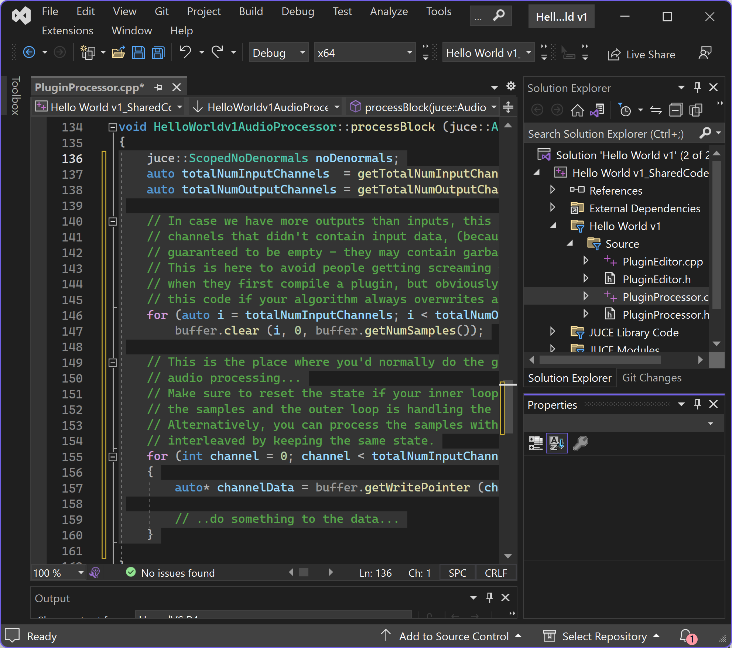
Auto-generated code
Four auto-generated files in source folder:
PluginEditor.cpp
PluginEditor.h
PluginProcessor.cpp
PluginProcessor.h
Open PluginProcessor.cpp file in your IDE
Scroll down until you reach processBlock
When JUCE auto-generated project files, a buffer array was created
This array of samples depends on block size set in your DAW
If your block size is set to 512 samples, array will have length 512
Delete all code between brackets

Slide 10
Edit the process block
Write this code into the process block:
for (int channel = 0; channel < getTotalNumOutputChannels(); ++channel)
{
for (int sample = 0; sample < buffer.getNumSamples(); sample++)
{ }
}
Loops through channels of input data
Typically 0 is left channel and 1 is right channel for stereo audio
For every channel, iterates through audio buffer but doesn’t change anything
We will use for loop to change value of each sample in the array

Slide 11
Edit the process block
Final process block generates random numbers for each sample:
void HelloWorldv1AudioProcessor::processBlock (juce::AudioBuffer<float>& buffer,
juce::MidiBuffer& midiMessages)
{
for (int channel = 0; channel < getTotalNumOutputChannels(); ++channel) {
auto* channelData = buffer.getWritePointer(channel);
for (int sample = 0; sample < buffer.getNumSamples(); sample++) {
channelData[sample] = 2.0 * (double)rand() / (RAND_MAX) - 1.0;
}
}
}
Audio samples represented as numbers between -1 and +1
rand() returns pseudorandom integer between 0 and RAND_MAX
(double)rand() / (RAND_MAX) is a double precision, real number between 0 and 1
2.0 * (double)rand() / (RAND_MAX) - 1.0 is double precision, real number between -1 and +1

Slide 12
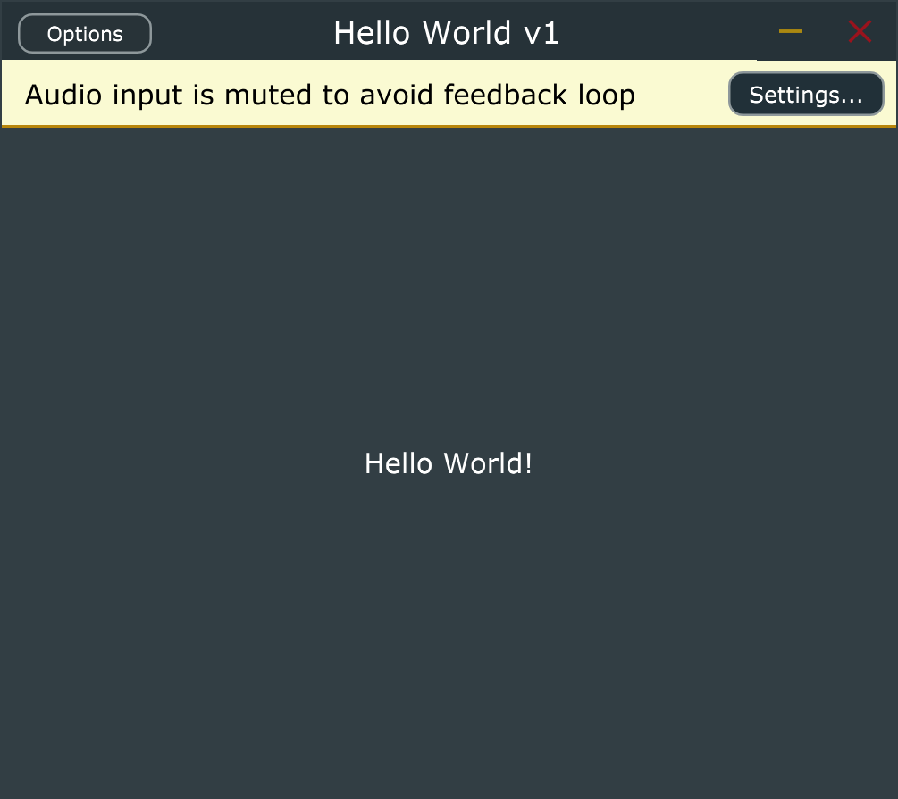
Build and run
Should have a simple stand-alone plug-in that just produces noise

